Slide 1

Hikvision Audio Products
Hikvision EU Product Team
Notes:
Welcome to join us on the hikvision audio products.

Slide 2
Contents
01 Overview
02 Network Product
03 Analog Product
04 Product Showcase
05 Function Demo
06 FAQ
Notes:
First of all, let’s have a overview about our new audio product.

Slide 3

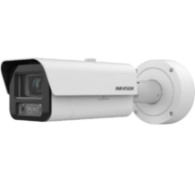

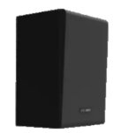



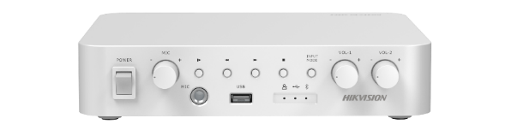




Why Hikvision Audio Products？
Multiple choice for products and solution
The power of “audio + video” security
Hikvision’s newly released audio product line (including Network Speaker, Analog Speaker and Amplifier) gives customers multiple choice for products and solutions.
network audio products Application
Video &audio linkage
Versatile functions for different applications
Easy operation and maintenance
Multiple broadcast modes
Hikvision Audio Products offer compatibility with IPC / NVR /HikCentral ensuring seamless integration into existing systems and unified management.
User-friendly interface supports batch device configuration and upgrades, streamlining both operation and maintenance procedures.
Two-way audio
Operator
Notes:
Firstly, before we start, here comes one question, why hikvision audio products?
We have different devices which give customer more choice
With audio product we can achieve The power of “audio + video” security
We have Versatile functions for different applications
4. Our audio products is Easy operation and maintenance

Slide 4
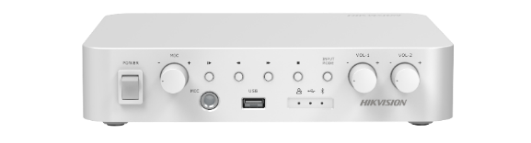
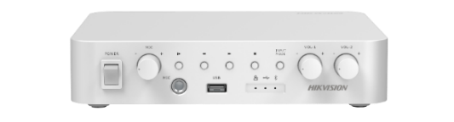



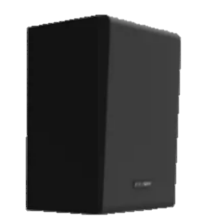
Audio Family Overview
Network products
Analog products
Network Amplifier
Analog Amplifier
Network Horn Speaker
Network Ceiling Speaker
Analog Ceiling Speaker
Analog Column Speaker
Network Column Speaker
Network Cabinet Speaker
Notes:
Here is our audio product family. We have network products and analog products.

Slide 5











Audio Solution Overview
Analog solution
Hybrid solution
Network solution
Analog Amplifier
Management Centre
Management Centre
Internet
Internet
Analog Speakers
…
/
…
Network Amplifier
IP Main Speakers
(Optional)
Analog Speakers
IP Sub Speakers
Network cable
…
/
…
Audio cable
Notes:
And for the audio products we also provide different kinds of audio solution, including analog solution, hybrid solution(schedule broadcast, TTS, alarm linkage, not support NVR currently) and network solution( two way audio except ceiling).

Slide 6
Contents
01 Overview
02 Network Product
03 Analog Product
04 Product Showcase
05 Function Demo
06 FAQ
Notes:
First of all, let’s have a overview about our new audio product.

Slide 7


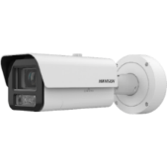


Hikvision Network Audio Products
Convergence advantage: from post-event investigation to in-event warning
“Audio + Video” – security’s new trend
Hikvision Network Speaker advantages
Long-term security industry experience
From Video Security to “Audio + Video” Security Applications Expansion based on long-time security experience
Investigation after the event
Based on CCTV technologies extended to audio products
IP access & management
Better platform integration
Algorithm development capabilities
Intervention during the event
Notes:
In IP CCTV system, we use IPC and NVR to achieve the smart event, but to achieve real-time notification is not easy.
With our network speaker, you can convergence advantage: From post-event investigation to in-event warning.
Also, our network has a lot of advantages:
Long-term security industry experience has many advantages: with “Audio and Video” Security Applications Expansion based on long-time security experience
Based on CCTV technologies extending to audio products,

Slide 8


Network Speaker - Key Features
Multiple broadcast modes
Easy operation & maintenance
Live broadcast
Scheduled broadcast
Alarm linkage broadcast
Support batch add devices & upgrade
Support one system double backup, for improved upgrade stability
Support remote configuration
Support NTP time synchronisation
TTS (text-to-speech)
Video & audio linkage
Support TTS function (English/Spanish/Russian)
Greatly improves the protection level with the combination of a Network Speaker with the CCTV system
Built-in eMMC
Two-way audio
eMMC can allocate space to store audio files
No need for an additional SD card
4GB eMMC (1GB for audio file storage)
HCP and Network Speaker (with built-in mic) can communicate via two-way audio function
Notes:
After introducing the family map and naming rules, Next, let’s see the key features of our network speakers.
Key features:
Multiple Broadcast Modes: support live broadcast, scheduled broadcast, alarm linkage broadcast.
TTS (Text-to-Speech): support TTS function, users can input text content, and the speaker can auto-generate audio for broadcast;
Built-in eMMC: our new network speaker has built-in eMMC that can allocate space to store audio files, with no need for extra SD cards;(10m max, 64G plan)
Two-way Audio: horn speaker, column speaker, and cabinet speaker has built-in mics, and it supports two-way audio with HCP;
Video & Audio Linkage: when IPC detects alarms, it can link networks speakers for broadcast, which can greatly improve the protection level;
Easy Operation & Maintenance: our new network speakers support batch upgrades, one system double backup, NTP time synchronization, etc. which are easy for operation and maintenance.

Slide 9
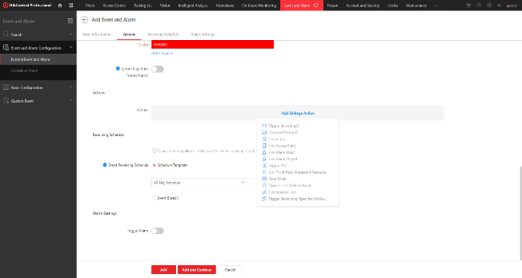
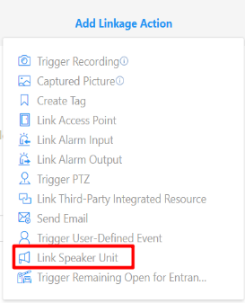
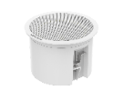




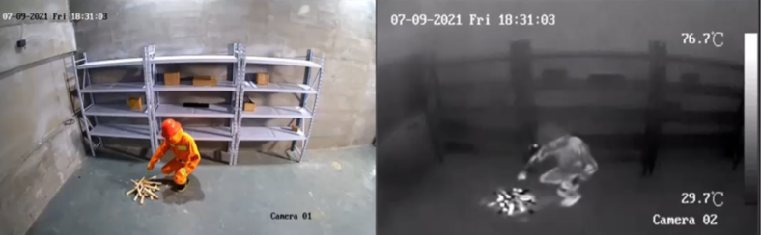

Key Features – Video & Audio Linkage
Combine Network Speaker with CCTV for better security protection
Video & audio linkage workflow
There are four ways to achieve the video-audio linkage function with a speaker
Speaker + IPC
Speaker + IPC+ NVR
Speaker + IPC + Platform software (HCP/HPP/HC)
Speaker +IPC + NVR + Platform software (HCP/HPP/HC)
Set linkage actions for Event and Alarm
Application scenarios
Perimeter protection
Danger prevention
Smart hybrid light camera with speaker
Notes:
The most important key features is that the network speaker can combine with CCTV for better security protection, such as perimeter protection and danger prevention.
You can use four ways to achieve the video-audio linkage function with speaker
Speaker + IPC
Speaker+ IPC+ NVR
Speaker +IPC + Plat from software (HCP/HPP/HC)
Speaker +IPC + NVR + Plat from software (HCP/HPP/HC)
Application scenarios such as perimeter protection, danger prevention, smart hybrid light with speaker and so on.

Slide 10






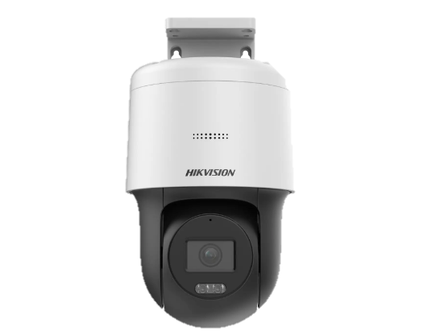

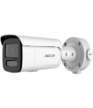

Key Features – Two-way Audio
Features
Support SIP protocol , with built-in dual-microphone to support Two-way Audio
There are three ways to achieve the Two-way Audio function:
NVR + IPC + IP Speaker
Platform software (HCP/HPP/HC) + NVR + IP Speaker
Platform software (HCP/HPP/HC) + IP Speaker
Two-way Audio topology
NVR
HikCentral
Professional
HPP
Hik-Connect
Internet
Note
The Horn Speaker, the cabinet and the Column Speaker support Two-way Audio, while the Ceiling Speaker model does not support that function. For more information, please check the product datasheet.
Network Speakers
IP Cameras
Notes:
Our network speaker support SIP protocol , with Built-in dual-microphone it can achieve Two-way Audio. You can use three ways to achieve the two-way audio function:
NVR+IPC+ Speaker
Plat from software(HCP/HPP/HC)+ NVR + Speaker
Plat from software(HCP/HPP/HC)+Speaker
Also please notice that, The Horn speaker, the cabinet and the column speaker support two-way audio, while the ceiling speaker model not support two-way audio function. For more information, you can check the product datasheet.

Slide 11
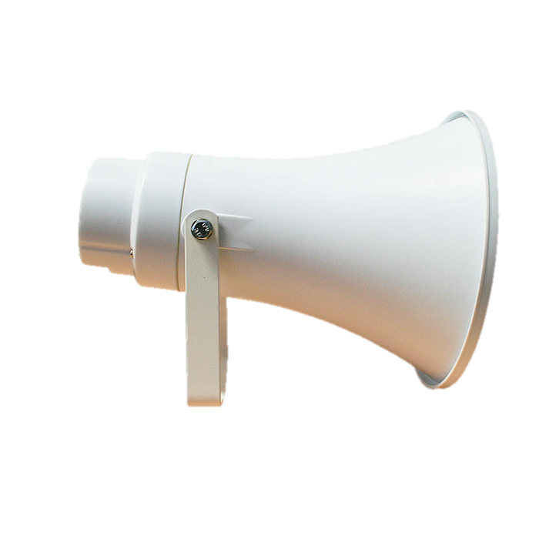
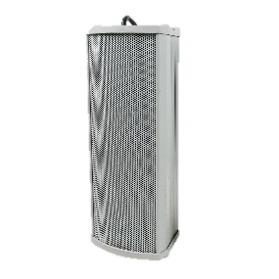

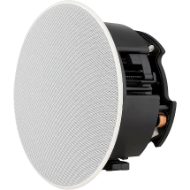
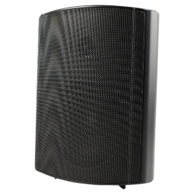
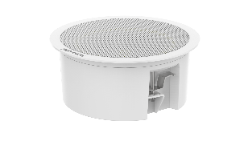
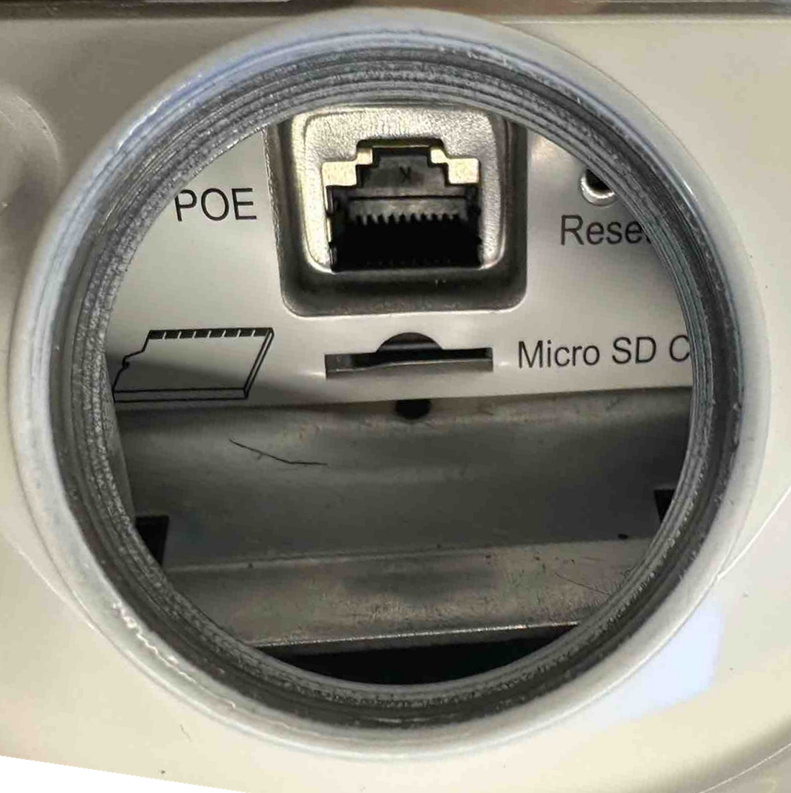
Key Features – Built-in eMMC
eMMC
Built-in eMMC can allocate audio file storage space
(1GB, each audio file ≤ 20M)
No need for extra SD card
Need SD card to store audio files
Conventional Network Speaker
Hikvision Network Speaker
Notes:
Another important feature is that our speaker has built in Emmc. Compared with other conventional speakers, they need SD card to store the audio file. But with our speaker you can store the audio in built in emmc.

Slide 12
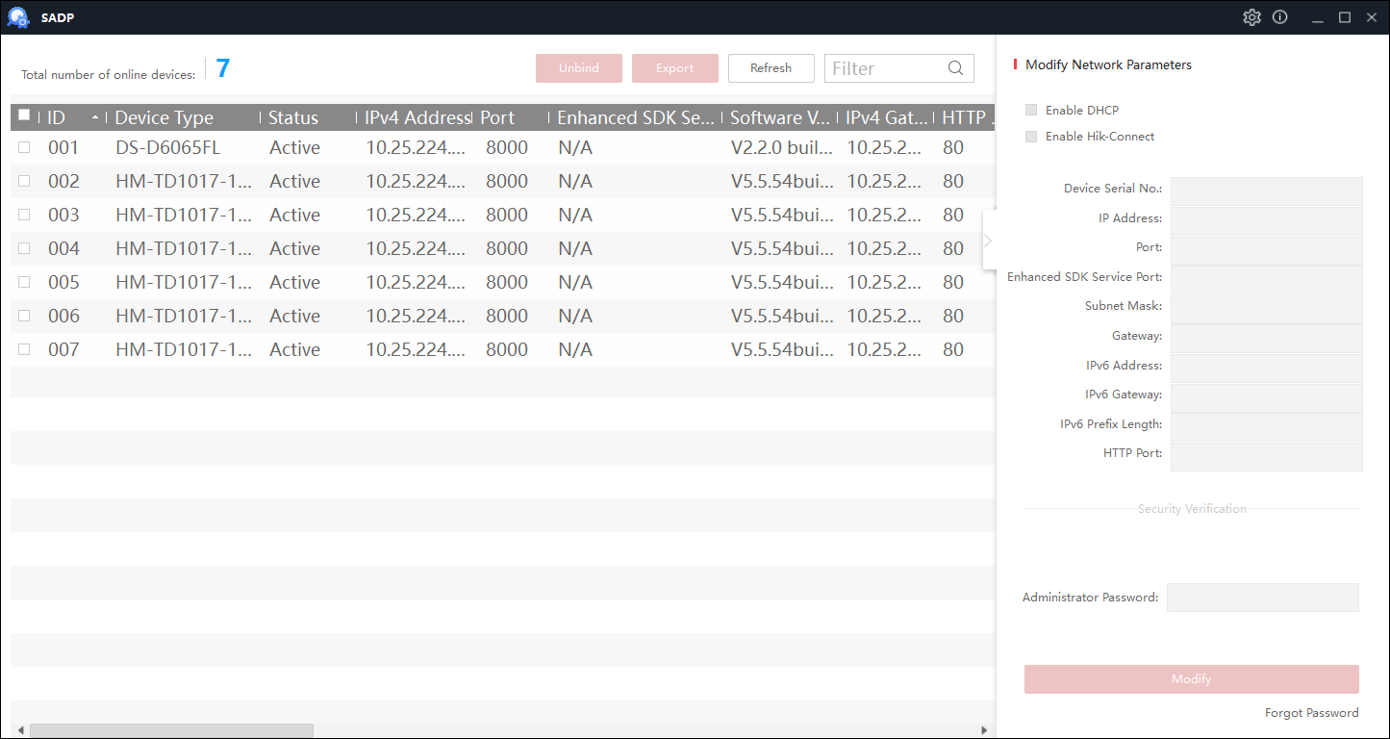
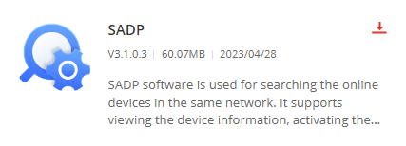
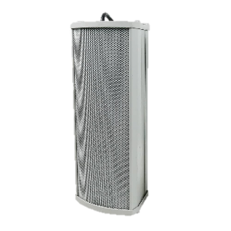
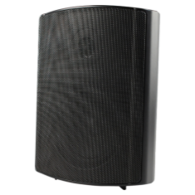
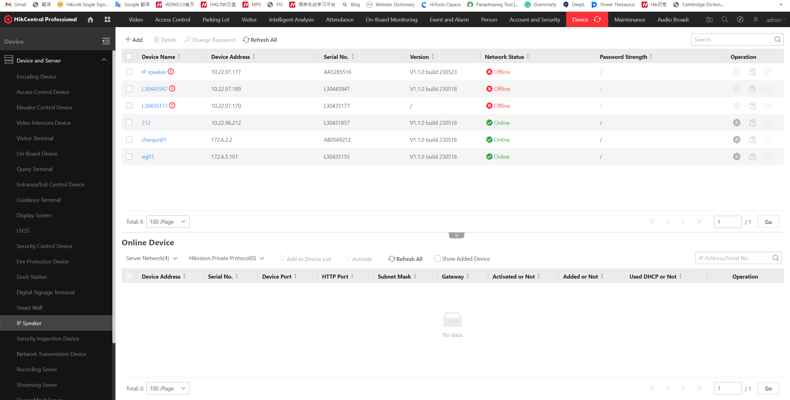
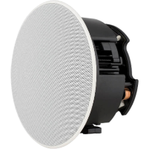
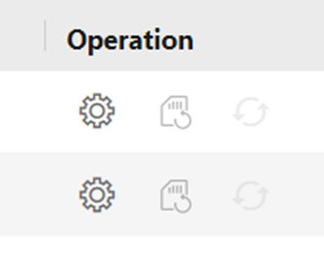
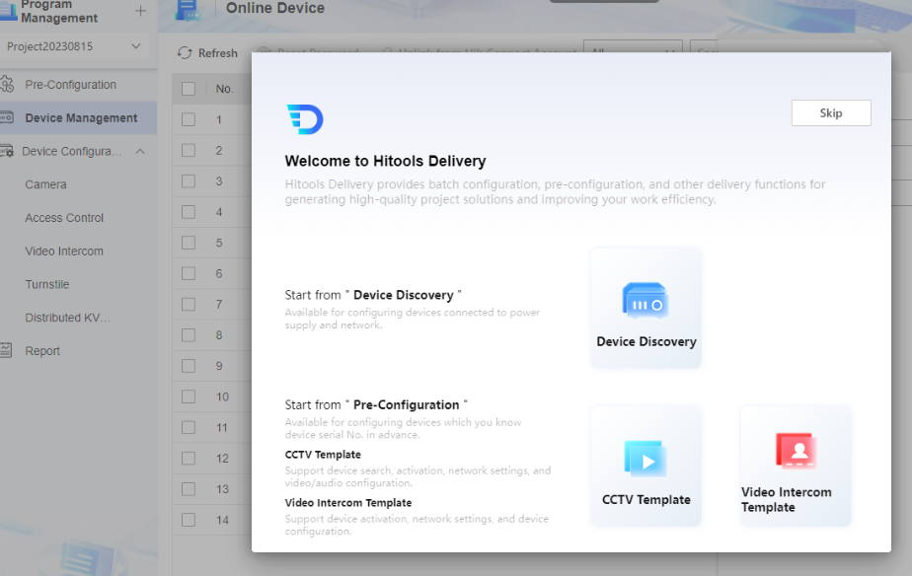
Key Features – Easy Operation & Maintenance
SADP for configuration, no need for third-party software
Remote configuration
on devices and software
Batch upgrade via ISAPI
(supports batch upgrade with Hikvision HiTools Delivery software)
Doesn’t support SADP, needs 3rd party configuration tool
Conventional Network Speaker
Hikvision Network Speaker
Notes:
Another important feature is that the device is easier to operation and Maintenance.
For the conventional network speaker, it is not very easy to find the device ip and to configure, sometimes you even need 3rd party configuration tools to configure one by one.
But with our hikvision network speaker. You can easily configure, for example: batch upgrade, SADP configuration, such as ip and password. What’s more, you can also configure remotely with Hik-central. We also plan to support in IPC ,PTZ and our NVR.

Slide 13


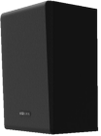


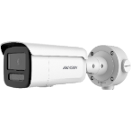
System Compatibility
To realise the management of IP speakers, you can use…
HikCentral Professional
Supported from baseline V2.4.1
iVMS-4200
Supported since December 2023 3.10.2.108
Hik-Partner Pro
Planned for 2024 Q2
Hik-Connect
Internet
Planned for 2024 Q2
Network Speakers
Switch
NVR
Supported on M/ AcuSense I(E)/DeepinMind M with GUI FW 5.02
Supported on AcuSense K NVR with EUI FW 4.82
Supported on AcuSense I(C) with customised FW 4.62.325
IP Camera
2/3/7 Series baseline cameras, planning for Q2
DE PTZ (T5) baseline planning for Q2

Slide 14

System Compatibility
Specific functions on different monitor centre:
Monitoring Centre | Audio File Management | Broadcast Plan Configuration | Alarm Linkage | Two-way Audio | Basic Configuration
HCP | √ | √ | √ | √ | √
iVMS -4200 | √ | √ | √ | √ | √
Baseline firmware NVR | √ |  | √ | √ | √
Customised firmware NVR |  |  | √ | √ | √
HPP | √ | √ | (NVR) | √ | √
HC | √ | √ | (NVR) | √ | √
Notes:
This page shows Specific functions on different monitor center such as audio file management

Slide 15

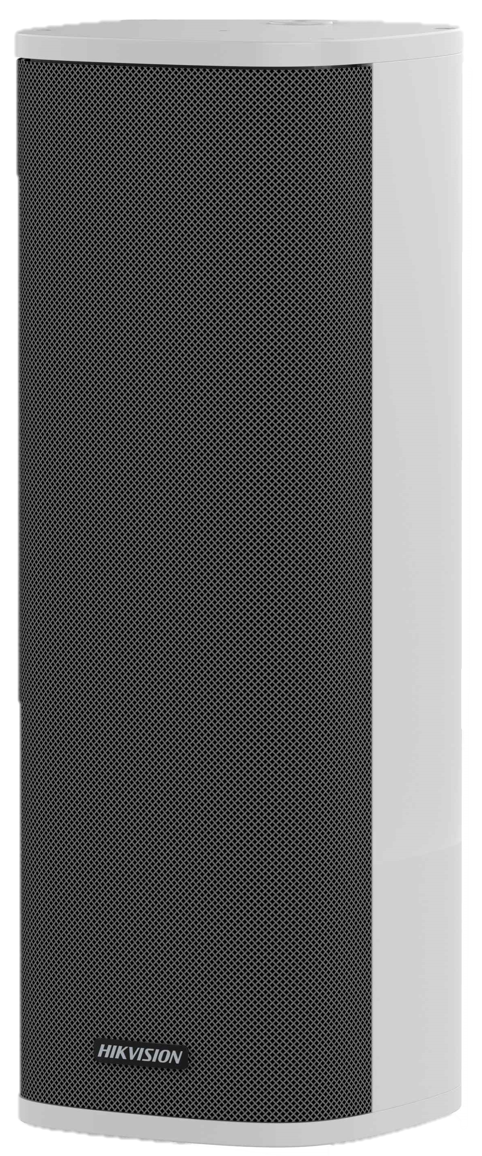
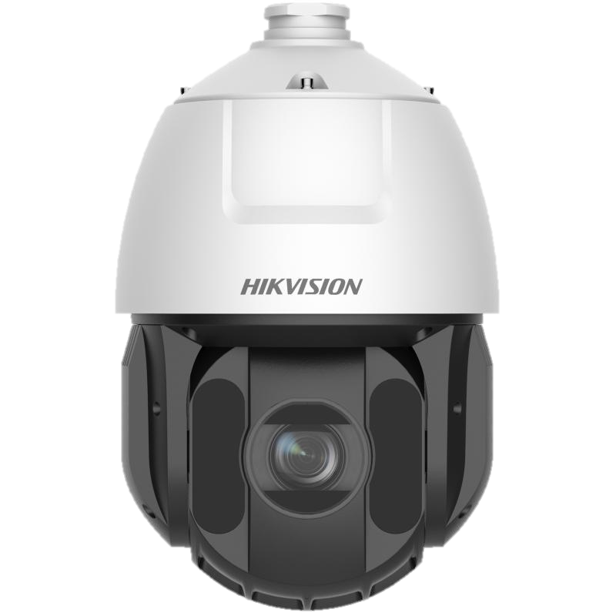



All-in-one Platform Management
Conventional Management
Hikvision Management
Audio system
CCTV system
Hikvision All-in-one Platform
Operator A
Operator B
Single Operator
Audio devices
Video devices
Audio & video devices

Slide 16


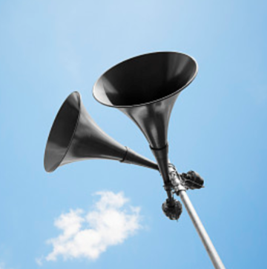
Network Speaker Applications Overview
Security protection
Background music
Paging & notification
Event triggered prerecorded message, Manually triggered Pre-recorded message, Two-way Audio
Scheduled broadcasting background music to build the right atmosphere and enhance the experience
Live broadcast for paging and real-time notification to improve the efficiency of message delivery
Typical scenarios: perimeter areas, restricted areas, riversides
Typical scenarios: retail stores, restaurants, shopping centres
Typical scenarios: airports, transportation, hospitals, construction sites, schools
Notes:
For the application, we list a lot of applications of network speakers for your reference.
As you can see from the introduction, we can use it in security protection, paging notification, and also you can use it as background music.
Above all, With Competitive price it is a good choice to use in multiple scenarios.

Slide 17

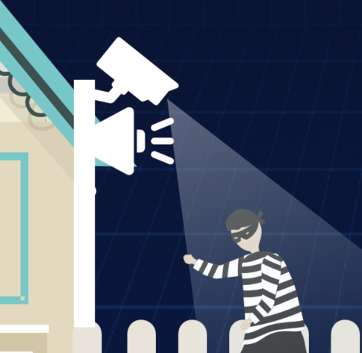





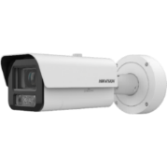

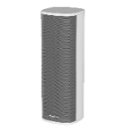
Network Speaker Application –
Security Protection
Monitoring Centre
Audio automatically triggered by event & alarm
NVR
(for small scenarios)
HikCentral Professional
（for medium & large scenarios)
or
Operator receive alarms
Live speech for deterrent
Internet
Support Two-way Audio
to enhance situational awareness
Operator
Camera
Network Speaker
…
…
IPC
PTZ
Horn Speaker
Column Speaker
Notes:
Among all the applications, here the most important usage of network speakers is for Security applications.
If some dangerous activities are detected, it will automatically trigger the speaker to broadcast for warning. Besides, when the operator spots potential dangers, the operator can live to speak or play audio messages to intervene before danger occurs. In some conditions customer can use the two-way audio function to achieve real time talk.

Slide 18


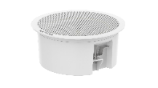
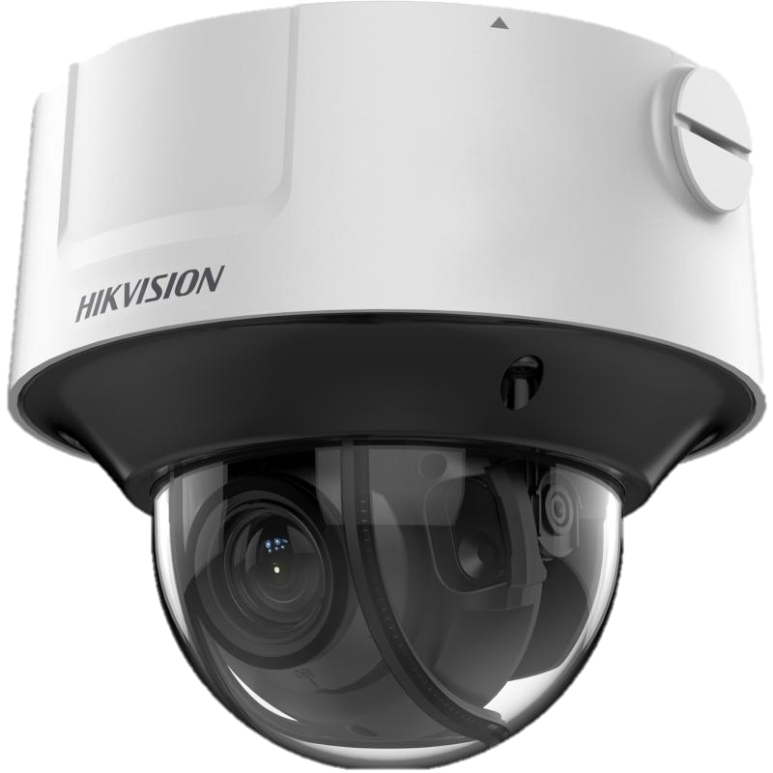
Network Speaker Application –
Background Music
Monitoring Centre
Scheduled broadcast to play background music
NVR
(for small scenarios, like small stores)
HikCentral Professional
（for medium & large scenarios, like shopping malls)
or
Internet
Camera
IP Speaker
…
…
IPC
Ceiling Speaker
Notes:
Customer can also use network speakers in multiple places such as stores or shopping malls for scheduled broadcast to play background music.

Slide 19
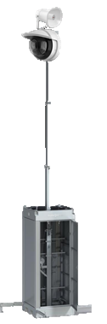
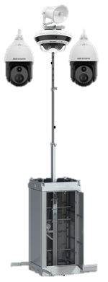

Network Speaker Application Scenarios -
Mobile Tower for Temporary Deployment
Light Perimeter Tower
Perimeter Tower Pro
Thermal Perimeter Tower
2
3
IP Speaker + Dome Camera
IP Speaker + PTZ + Turret Camera
IP Speaker + Thermal PTZ
3
3
On a construction site , renting a mobile surveillance tower can provide a safe and economical security solution, including:
Perimeter protection
Long distance safety protection
Notification and broadcast
1
Notes:
Mobile Tower for Temporary Deployment is a typical application scenario for network speaker, we can combine with hikvision CCTV products for construction site scene to provide a safe and economical security solution, including:
Employee personal safety protection;
Assets safety protection;
Perimeter defense;
Working hours broadcast.

Slide 20

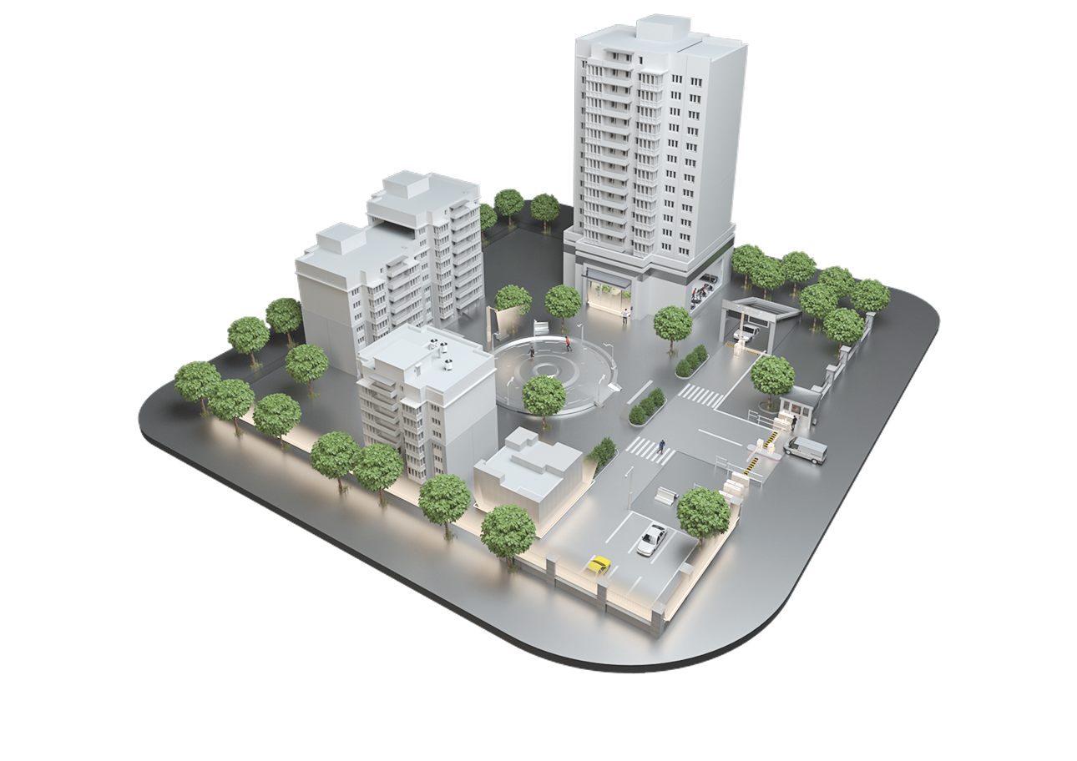
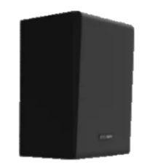
Typical Application Scenarios - Building
1. Building park
Play background music
Emergency mustering (Fire alarm, evacuation, etc.)
2. Perimeter areas
Security system (work with CCTV to improve the protection level)
5
4
3. Car parks
Audio for car park management
Two-way Audio with guard/operator
2
4. Conference rooms
Bluetooth/wired connection to play audio files/sound amplification
1
3
5. Halls / public indoor areas
Play background music
Emergency mustering (Fire alarm, evacuation, etc.)

Slide 21


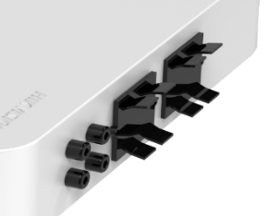


Network Amplifier –
Hybrid Solution: make audio more flexible
Audio input: USB/Bluetooth/MIC/RCA
Management Centre
Switch
Network Amplifier
DS-QAE1A80G1-VB
Upgrade plan
80W Power
2-zone Control
Convert the analog system to an IP system to support more intelligent functions such as schedule broadcasting/ remote management/alarm linkage.
Analog Speakers
Analog Speakers
New Installation plan
Analog speaker + network amplifier solution, providing a smarter experience similar to network audio systems with low budget.
Network Cable
Audio Cable
Notes:
To achieve the hybrid function with network and analog products, we will release a Network Amplifier , which can make audio more flexible.
We have the upgrade plan from analog system to ip system, and have the new installation plan. Analog speaker with network amplifier solution, providing a smarter experience similar to network audio systems with low budget.

Slide 22
Contents
01 Overview
02 Network Product
03 Analog Product
04 Product Showcase
05 Function Demo
06 FAQ
Notes:
First of all, let’s have a overview about our new audio product.

Slide 23
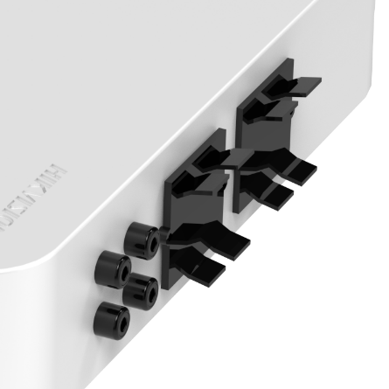
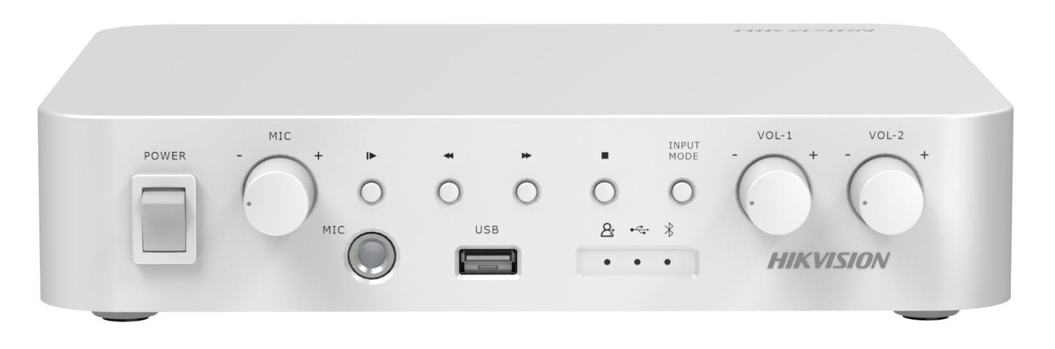

Analog Speaker Setup - Topology
60W constant resistance/constant voltage Amplifier
Audio input: USB/Bluetooth/MIC/RCA
Power consumption ≤ 30w
Power consumption ≤ 30w
Analog Speakers
* Speakers overall power consumption ≤ 60w
Notes:
This is the analog speaker setup topology, here is the analog amplifier, which has audio input with USB, Bluetooth, MIC and RCA in the device interface. With 60W constant resistance or constant voltage amplifier, you can connect the analog amplifier to the ceiling speaker or column speaker.
Aanlog speaker doesn’t have EN54 certificate for fire alarm solution.

Slide 24







Analog Speaker –
Creates more possibilities for S-SMB scenarios
Applications such as advertising playback and background music
Audio Ads
Background music
Queue calling
Notes:
For the analog speaker, we released analog speaker to create more possibilities for S-SMB scenarios.
With our product, customer can play background music, advertising and queue calling in places such as stores and malls. It is very to use.

Slide 25
Contents
01 Overview
02 Network Product
03 Analog Product
04 Product Showcase
05 Function Demo
06 FAQ
Notes:
First of all, let’s have a overview about our new audio product.

Slide 26
Audio Product Naming Rules
① ② ③ ④ ⑤ ⑥ ⑦ ⑧ ⑨ ⑩
DS - QA Z 1 3 07 G 1 (T) - E
DS:
Hikvision Product
V/R/S/W/B/E：
V: Constant voltage
R: Constant resistance
S: Sub speaker
W: Wi-Fi
B: Bluetooth
E: PoE/PoE+
QA:
Audio & Sensing product line
Z/E:
Product series
Z:Z Series
E: E Series
T：
Pigtail
1/0：
Transmission type
1: Network Speaker
0: Analog Speaker
1:
1st generation
G:
Global products
1/2/3/4/A：
Appearance
1: Wall Speaker
2: Ceiling Speaker
3: Horn Speaker
4: Column Speaker
A: Amplifier
Power Consumption
0X: 0-9W
1X: 10-19W
2X: 20-29W
3X: 30-39W
6X: 60-69W
AX: 1X0W
Notes:
This is the network speaker naming rules. As you can see:
DS means our hikvison product;
QA means Audio and Sensing Product;
Z means product series and 1 means that it is a network speaker.
The fifth part 3 means the device appearance, it is a Horn Speaker .
Later comes the power consumption, the generation. T means the device has pigtails.
The past words in the naming rules means the features, E means it support POE.

Slide 27

Network Audio Product Showcase
Main Speaker
Sub Speaker
Amplifier
Network Horn Main Speaker
Network Column Main Speaker
Network Ceiling Sub Speaker
Network Amplifier
DS-QAZ1307G1T-E
DS-QAZ1307G1-E
DS-QAZ1325G1T
DS-QAZ1430G1
DS-QAZ1460G1
DS-QAZ14A2G1
DS-QAZ0206G1-S
DS-QAE1A80G1-VB
1 main speaker supports max 1 sub speakers
Network Ceiling Main Speaker
Network Cabinet Main Speaker
Network Cabinet Sub Speaker
DS-QAZ1206G1-BE
DS-QAZ1110G1-B
DS-QAZ1120G1-B
DS-QAZ0110G1-S
1 Main Speaker supports max 1 Sub Speaker

Slide 28

Analog Speaker Product Showcase
Analog Speaker
Analog Amplifier
DS-QAE0206G1-V
DS-QAE0420G1-V
DS-QAE0A60G1-VB
Analog Ceiling Speaker
6W
Constant voltage
Support speaker spring terminal audio line input
Analog Column Speaker
20W
Constant voltage
Support speaker spring terminal audio line input
60W Analog Amplifier
Audio input: USB/Bluetooth/MIC/RCA
Output volume and mic input volume adjustment
Support two-zone volume adjustment
Support multiple amplifiers cascaded via RCA cables
* Actual products may vary due to product enhancement or change.
Notes:
This is the analog speaker family map. As you can see we have analog ceiling speaker, column speaker, and analog amplifier to meet different demand.

Slide 29
Audio Product Solution
Economical
Cost Effective
Fully Functional
60W Analog Amplifier
Web/Hik-connect
NVR/HCP
DS-QAE0A60G1-VB
Internet
Internet
Analog Speakers
…
/
…
Network Amplifier
IP Main speakers
DS-QAE0206G1-V
DS-QAE0420G1-V
DS-QAE1A80G1-VB
(Optional)
Analog speakers
IP Sub Speakers
Network cable
…
/
…
Audio cable
DS-QAE0206G1-V
DS-QAE0420G1-V
Notes:
This is the final conclusion about the audio products solution.
For economical solution, you can choose analog amplifier and speakers.
For the cost effective solution, you can use the hybrid solution, connecting the analog speakers to network amplifier, then you can configure and manage with web or hik-connect.
If you want the fully function, you can use the network solution, with network main and sub speaker s connect to the internet, and nvr or hcp can be used for the configuration and management.

Slide 30
Contents
01 Overview
02 Network Product
03 Analog Product
04 Product Showcase
05 Function Demo
06 FAQ

Slide 31
Contents
01 Overview
02 Network Product
03 Analog Product
04 Product Showcase
05 Function Demo
06 FAQ

Slide 32
Thanks
Notes:
That’s all about our webinar , thank you everyone. If you have any question on our product you can contact regional sales or regional technical support for help.

